Slide 1
Voter’s Education Program 2023
A quick review…
What’s on the upcoming ballot?
Questions + Resources

Slide 2
Overview
August 8th special election
November 7th special election
Issue 1- Present in both
Notes:
August 8th of this year held a special election- we will go over what was covered in this special election, the outcome and the implications for the upcoming election
November 7 is coming up in approx 3 short weeks, we will go over the two issues being presented in the upcoming election
Brief clarification regarding double use of “issue 1” language

Slide 3
August 8th- Special election
Issue 1
Language
“The proposed amendment would:
1) require that any proposed amendment of the Constitution of the State of Ohio receive the approval of at least 60% of eligible voters voting on the proposed amendment
2) Require that any initiative petition filed on or after January 1st , 2024, with the Secretary of State proposing to amend the Constitution of the State of Ohio be signed by at least five percent of the electors of each county based on the total vote in the county for governor in the last preceding election
3) Specify that additional signatures may not be added to an initiative petition proposing to amend the Constitution of the State of Ohio that is filed with the Secretary of State on or after January 1, 2024 proposing to amend the Constitution of the State of Ohio
If passed, the amendment will be effective immediately”

Slide 4
A lot of legal/ political lingo…
Distilled down, the August 8th iteration of Issue 1:
1) Requires a 60% majority to pass any proposed amendment to the Constitution of the State of Ohio
2) Any petition aimed to amend the constitution after January 1st 2024, must have signatures from 5% of voters from each county
3) All amendments filed after January 1st 2024 cannot have signatures added after filing

Slide 5
Arguments For and Against
For (Yes)
Elevates the minimum threshold for passing an amendment
Aimed to protect the interests of Ohioans on the individual level
Poised to allow only one attempt to gather signatures for proposed amendment approval
Against (No)
Destroys citizen-driven ballot initiatives
Undermines essence of majority rules (>50%)
Is a universal qualification going forward

Slide 6
Outcome from August 8th
No= 57%
Yes= 43%
“Ohio Voters Reject Issue 1 in Special Election”

Slide 7
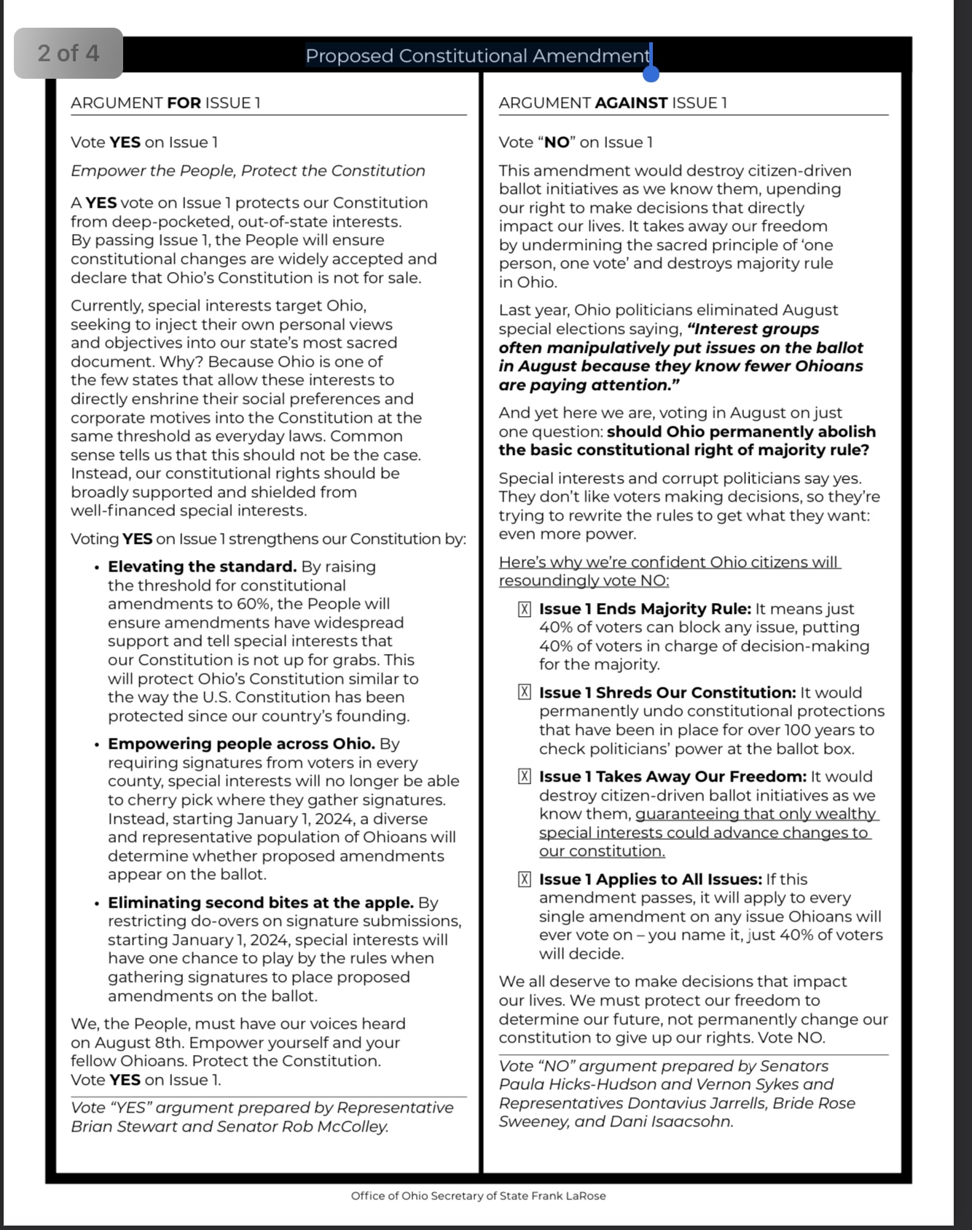
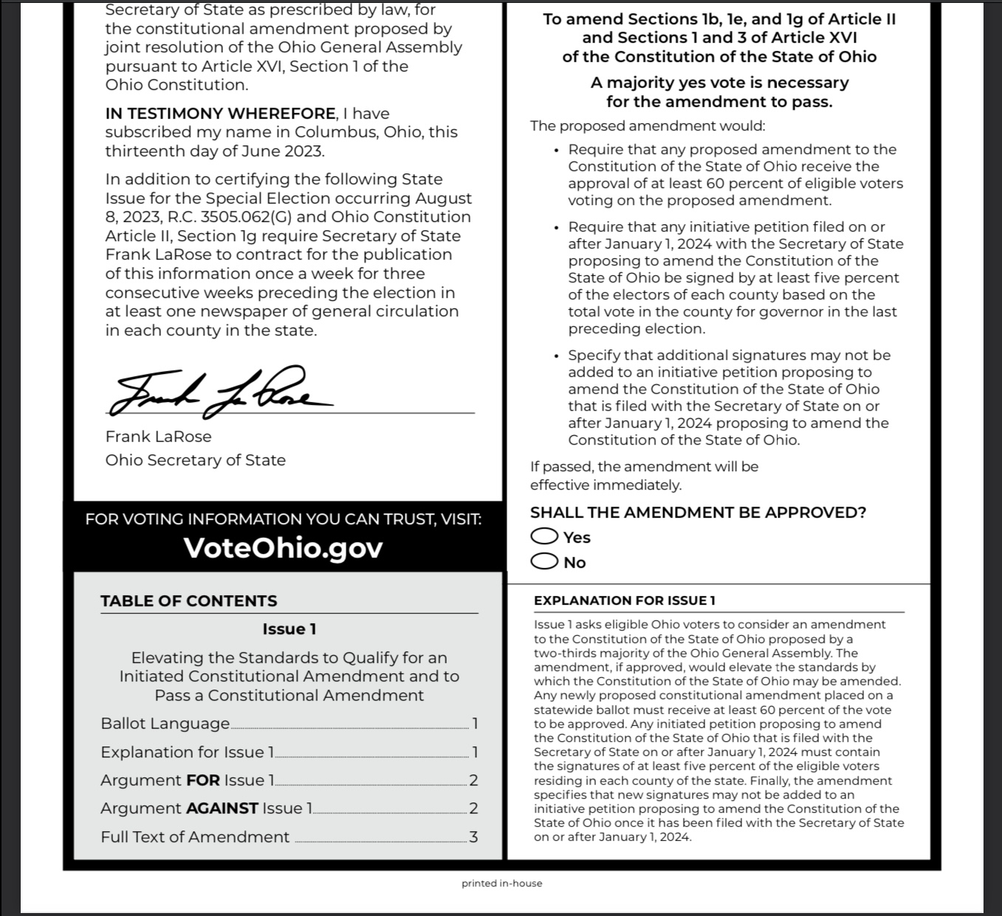
What does a ballot look like?

Slide 8
November 7th Special Election
Issue 1
Different than Issue 1 from August election
Language:
“Establish in the Constitution of the State of Ohio an individual right to one’s own reproductive medical treatment, including but not limited to abortion”
“Create legal protections for any person or entity that assists a person with receiving reproductive medical treatment, including but not limited to abortion”
“Prohibit the State from directly or indirectly burdening, penalizing, or prohibiting abortion before an unborn child is determined to be viable, unless the State demonstrates that it is using the least restrictive means”
“Grant a pregnant woman’s treating physician the authority to determine, on a case-by-case basis, whether an unborn child is viable”
“Only allow the State to prohibit an abortion after an unborn child is determined by a pregnant woman’s treating physician to be viable and only if the physician does not consider the abortion necessary to protect the pregnant woman’s life or health”
“Always allow an unborn child to be aborted at any stage of pregnancy, regardless of viability if, in the treating physician’s determination, the abortion is necessary to protect the pregnant woman’s life or health”

Slide 9
November 7th Special Election
Issue 2
Language- much lengthier and more involved
https://www.ohiosos.gov/globalassets/ballotboard/2023/issue-2-certified-language---08-24-23.pdf
Key points:
Define adult use recreational cannabis
Create a regulatory decision and legalize cultivation, processing and sale for adults 21+
Establish cannabis based jobs, social equity stipulations, protections for medical cannabis patients
Establish clauses for employers, landlords and safe use (i.e. not while operative a motor vehicle)
Change laws related to financial support of cannabis testing labs
Fund a program for cannabis addiction services
Taxation clauses related to cannabis sales

Slide 10
November 7th Distilled Down
Issue 1
Main focus: Implementing constitutional protections for reproductive rights, slight focus on abortion
Puts medical professionals at the forefront of the reproductive decisions with women + protections for medical professionals/facilities that perform abortions
Stipulations regarding viability of fetus/unborn child and safety of mother
Prevents State from punitive actions against these individuals/facilities
Issue 2
Regulation, legalization and commercialization of cannabis in the state of Ohio
Extension of medical legalization in 2016 to full adult recreational use
Creation of additional funds/ taxes generation for the state government with portions allocated to support to substance abuse/addiction, tax commissions, and cannabis social equity and jobs
I will provide additional resources for constituents to use for more information

Slide 11
Questions?

Slide 12
Resources
https://www.ohiosos.gov/globalassets/ballotboard/2023/certified-language-9-21-ballot-board.pdf
https://www.ohiosos.gov/globalassets/ballotboard/2023/issue-2-certified-language---08-24-23.pdf
https://www.ohiosos.gov/media-center/press-releases/2023/2023-09-22/
https://ballotpedia.org/Ohio_2023_ballot_measures
Find your sample ballot here: https://www.ohiosos.gov/elections/voters/toolkit/sample-ballot/
Find your polling location: https://www.ohiosos.gov/elections/voters/toolkit/polling-location/
ID requirements: https://www.ohiosos.gov/elections/voters/id-requirements/
Absentee voting: https://www.ohiosos.gov/elections/voters/how-to-request-your-absentee-ballot/
OSU Votes: https://lead.osu.edu/community-engagement/osu-votes

